Slide 1

GreenHorn Staffing
Let us find your unicorn
Vladislav Epelboym, Matthew Rao, Mitchell Fridman

Slide 2

Recruitment Agency Application
This project aims to provide a platform for our recruitment agents to view available jobs from our business clients and pre-screen the best possible candidates for the jobs.

Slide 3
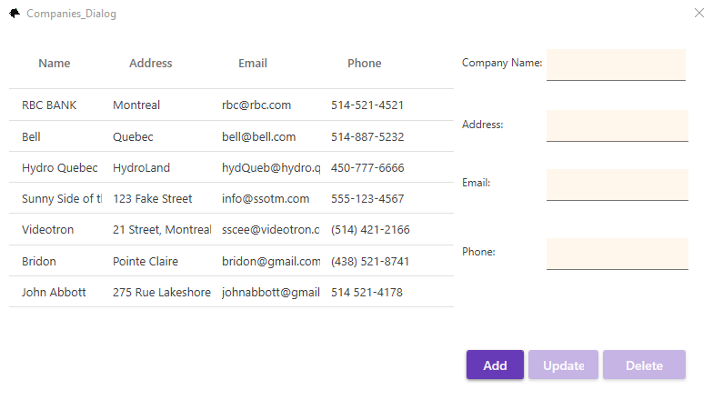
Companies
The ‘Companies’ window allows us to do CRUD functions for our clients.
Fields include Company Name, Address, Email, and Phone Number.

Slide 4
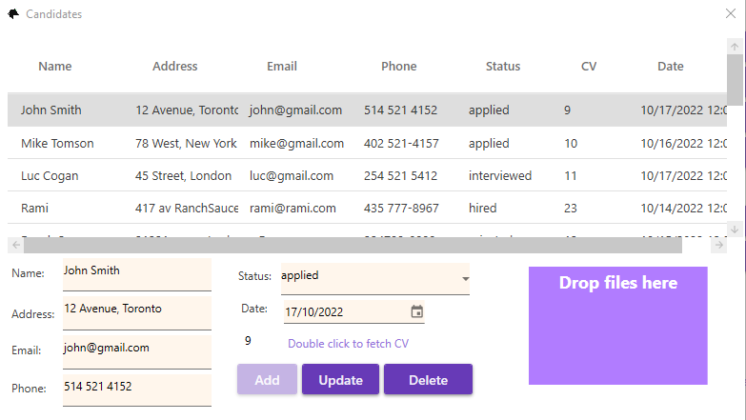
Candidates
Our ‘Candidates window allows us to do CRUD operations for the talent we have scouted, and track their status in the hiring process.
Of note is the ‘Drag and Drop’ section to add CVs, and the area to double click to fetch uploaded CVs.

Slide 5
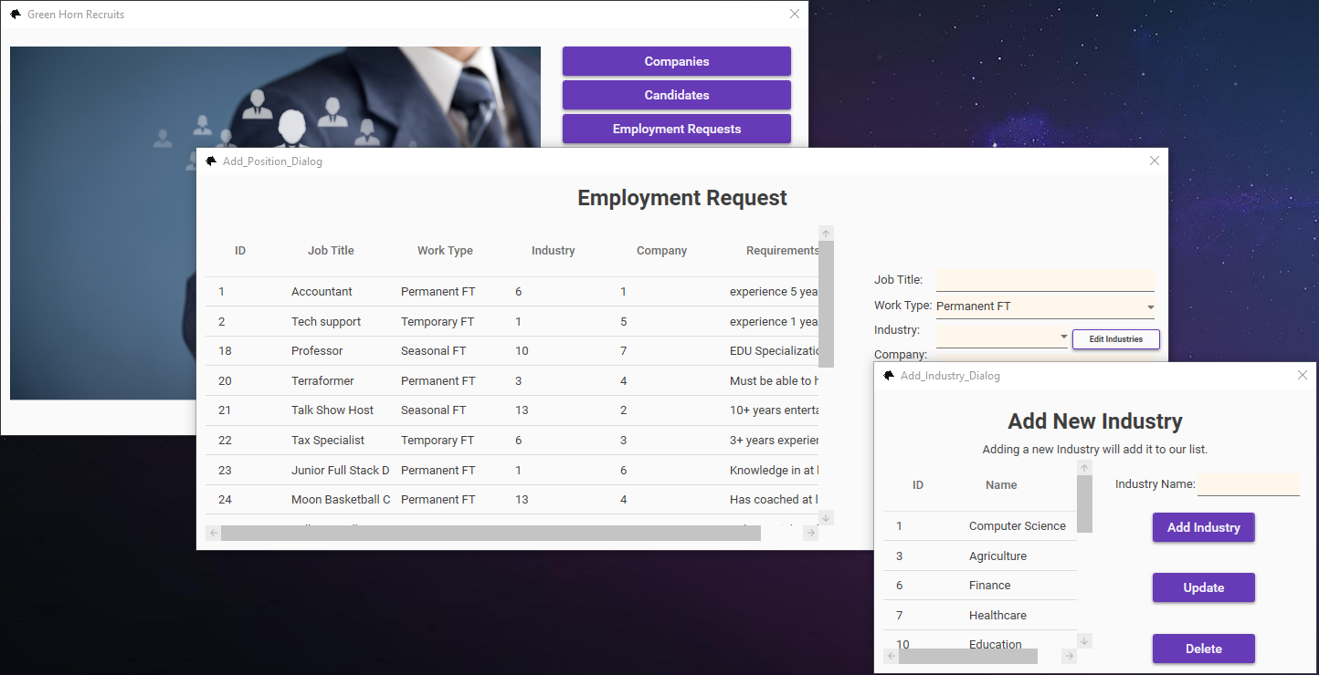
Positions
Allows us to perform CRUD operations on the employment needs of our clients.
Of note is the Companies dynamic combobox that takes information from the Companies table, and the Industry combobox that does the same from the Industries table, which can be accessed directly from this window.

Slide 6
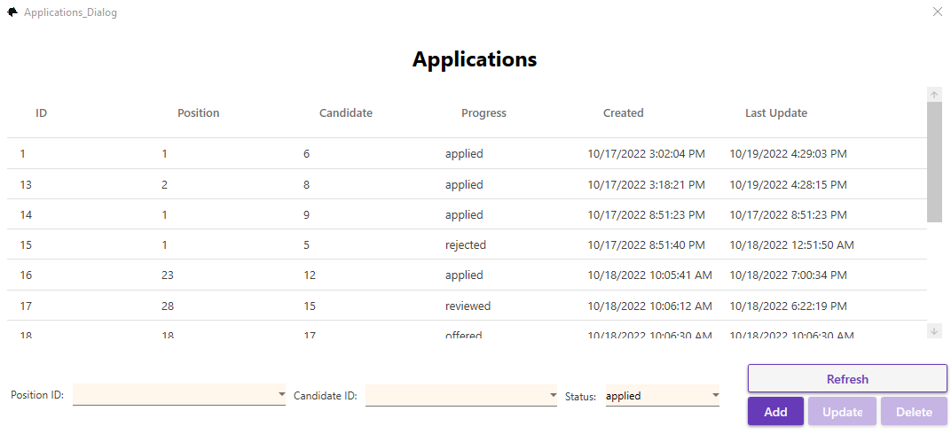
Applications
The Applications window allows us to track the status of which candidates have applied for which positions with CRUD functionalities.
We included a refresh button in this window so we can ensure the most up-to-date information in case other users are editing data at the same time.

Slide 7
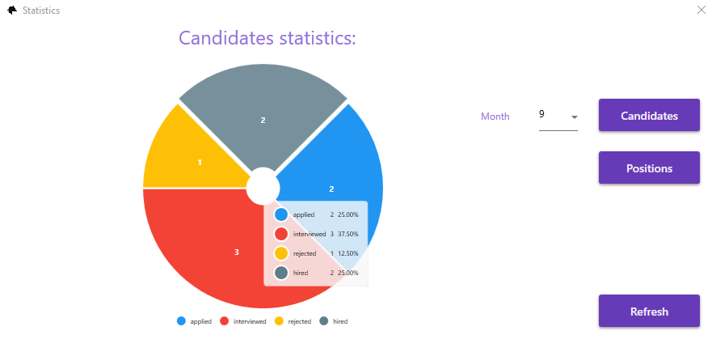
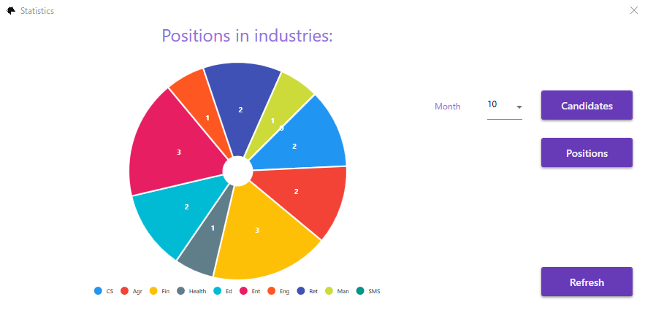
Statistics
We included donut charts for statistics on our Candidates and Positions. You can hover to show additional data.

Slide 8
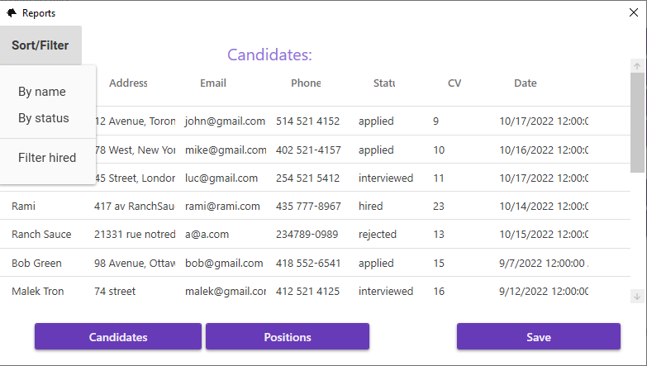
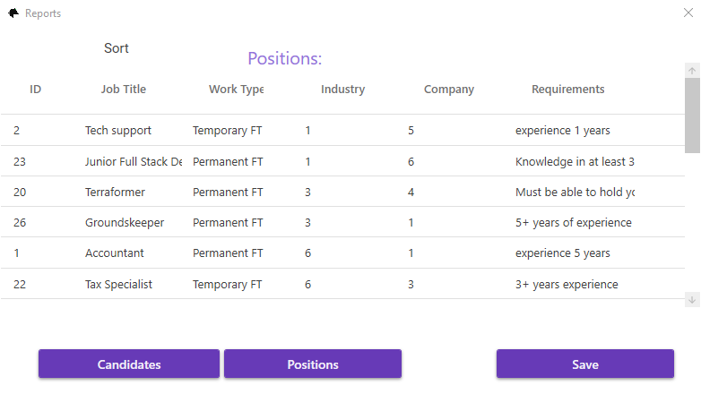
Reports
We have reports for Candidates and Positions as well. These reports can be sorted, filtered, and then saved to the user’s computer or printed in hard copy.

Slide 9
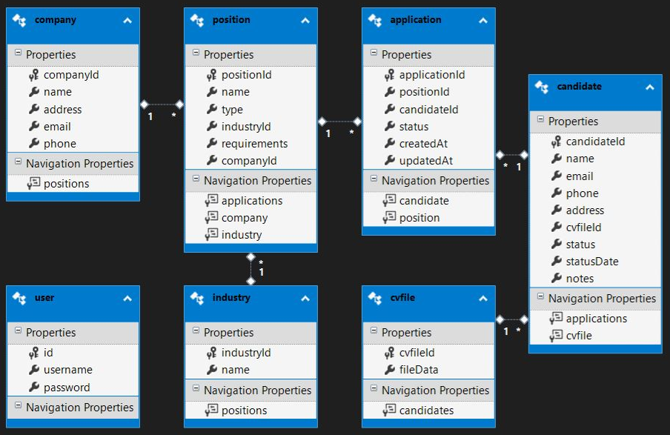
Challenges & Solutions 1
Database Diagram

Slide 10
Challenges & Solutions 2
Technologies Used
Material Design
Entity Framework
LINQ
Azure – DB storage
MSTest.TestFramework
LiveCharts

Slide 11
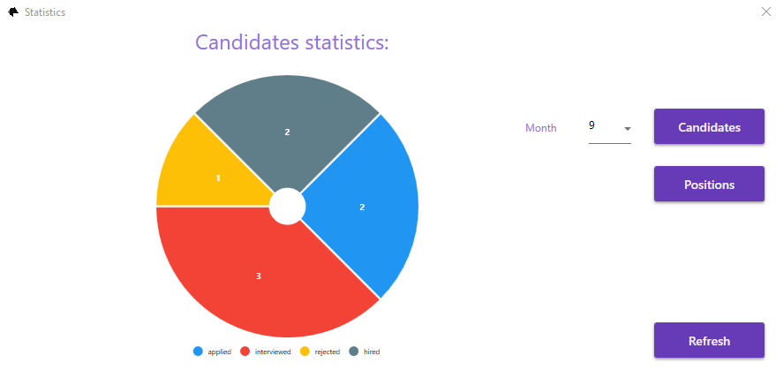
Challenges & Solutions 3
Refresh Issue With Charts

Slide 12
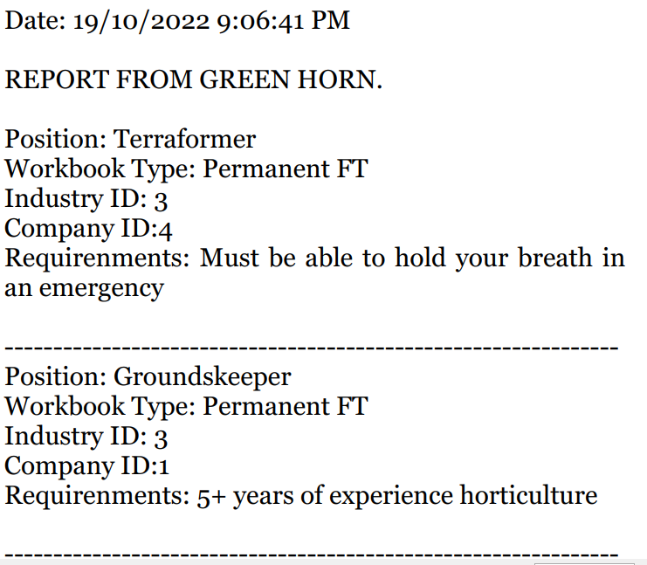
Challenges & Solutions 4
Formatting PDFs for saving and printing

Slide 13
Teach it 1
How we implemented the installer
6-Minute Youtube Video Tutorial!
https://youtu.be/mTkh3sgh6tI
Installer

Slide 14
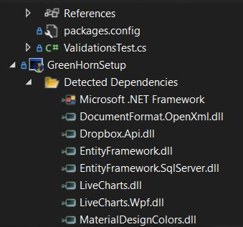
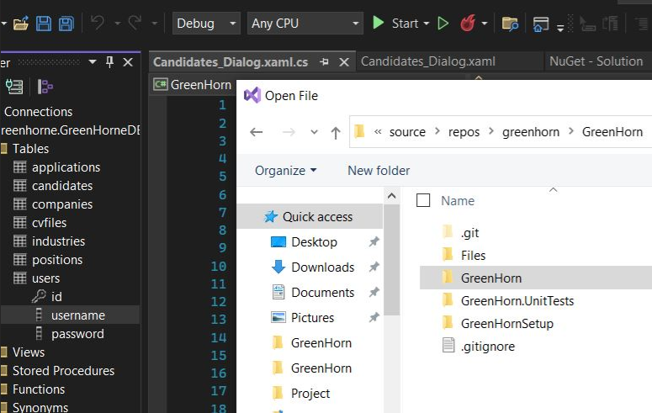
Teach it 1
Installer

Slide 15
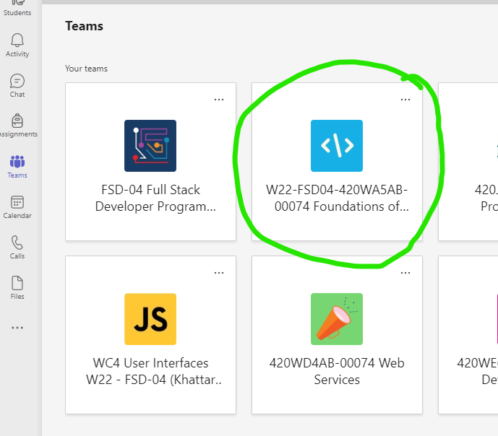
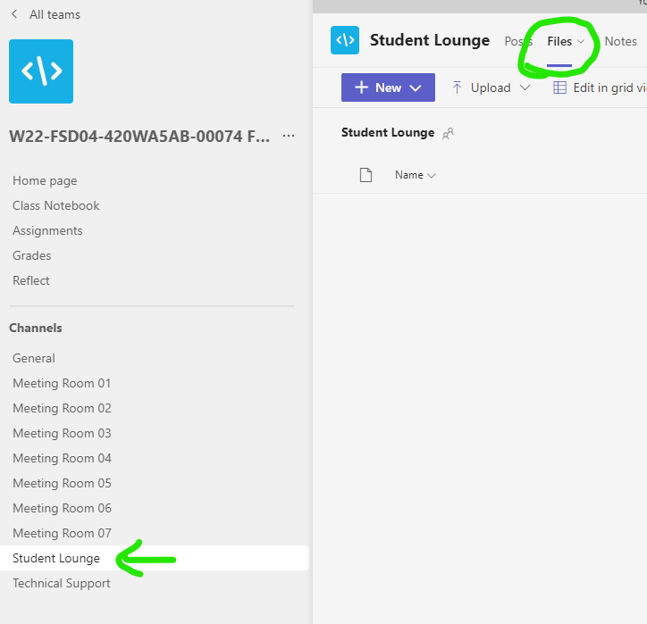
Teach it 1
Installer
Look in Teams for Foundations of Web Development, Student Lounge, Files
Username: guest
Password: 12345678

Slide 16
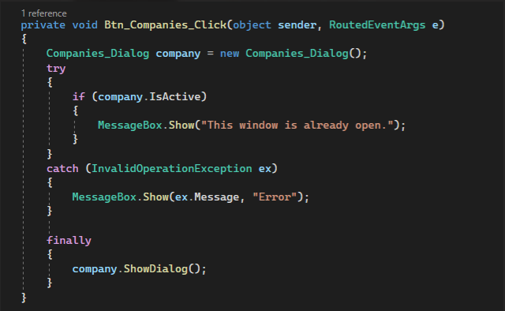
Teach it 2
Multiple Login windows were opening

Slide 17
Future Work
Improve statistics and charts
Reload animations
Some quality of life improvements

Slide 18

Summary
We started with basic CRUD for all of our tables.
Companies
Candidates
Positions
Applications
Added in charts, statistics, reports, and an installer.
Our final result was an application suited for any successful recruitment agency!

